Slide 1
React18

Slide 2
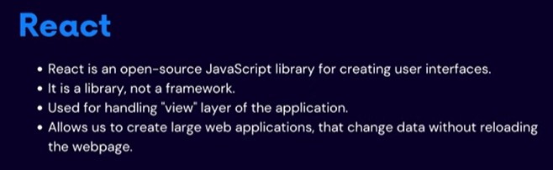
React18

Slide 3

React18

Slide 4
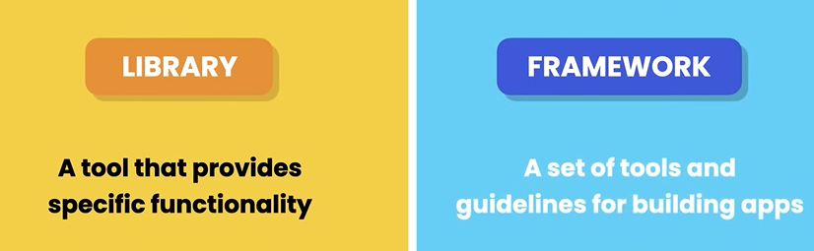
React18
npx create-react-app my-app --template typescript

Slide 5
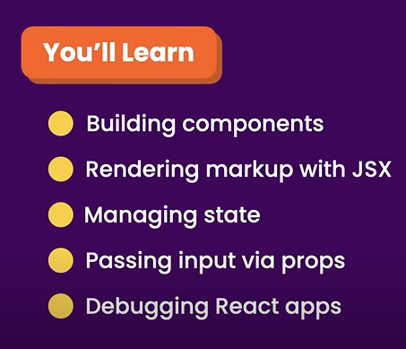
React18

Slide 6
Thank You

